Slide 2
Indian Medical Device Industry- Salient features
India is the 4th largest market for medical devices in Asia and among the top 20 markets for medical devices in the world
Current Market size for medical devices in India is USD 11 billion and the Market size expected to reach USD 50 bn by 2025
100% FDI is allowed under the automatic route. FDI inflows in Medical and Surgical Appliances from April 2000 - Sept 2020 were to the tune of $2.17 bn.
Government of India recognized Medical Devices as a sunrise sector under Make in India campaign, 2014
‘Make in India’ initiative by the Indian government is aimed to help boost domestic manufacturing and export competitiveness of this industry.
Changes in medical regulatory framework for medical devices in India aims towards ensuring quality and safety of these medical devices at par with the international standards.

Slide 3
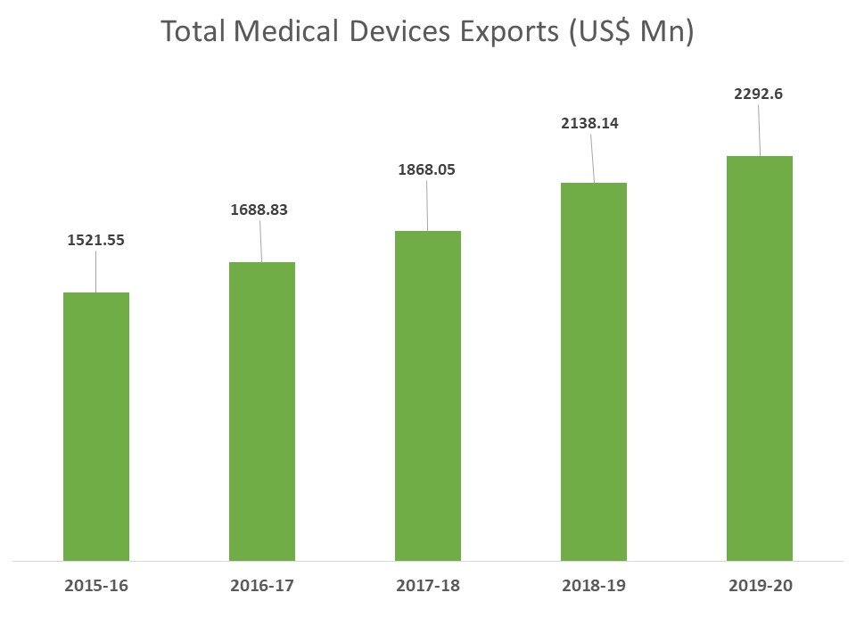
Indian Medical Device Industry- Trend in Exports

Slide 4
India’s exports of medical devices
USA

Slide 5
Key trend in Indian medical device industry

Slide 6
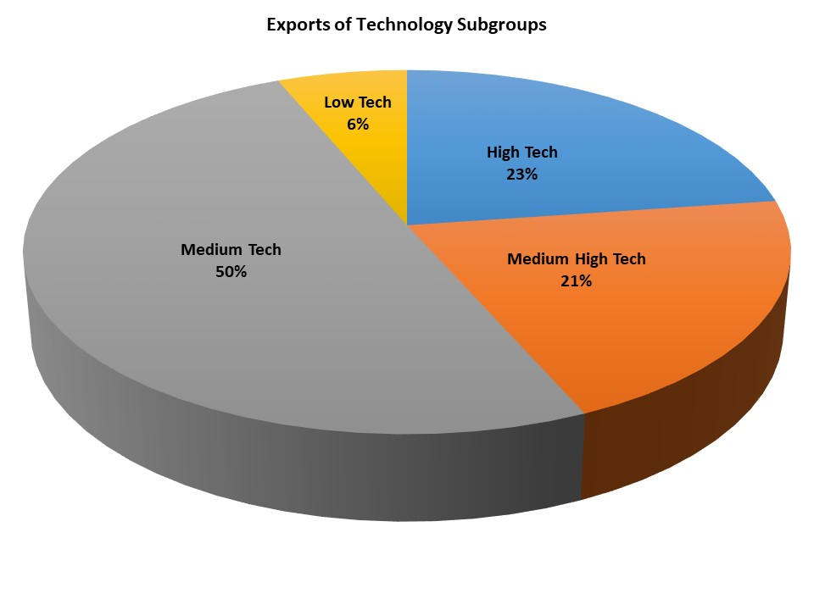
Indian Medical Device Industry- Exports of Technology Subgroups

Slide 7
Why EU?
EU is one of the major destinations for India’s medical device exports.
India’s exports of medical devices to Europe has seen a consistent growth over the last few years rising from 308.28 million uSD in 2014-15 to 430.71 million USD in Yr 2019-20.
Germany, France, Spain, Italy, Belgium & UK are major markts in India’s export of medical evices
European companies are also one of the major investors in India’s medical device landscape
Many of the European medical device companies like Medtronics, GE Healthcare, Siemens are having operations in India
India is looking at EU not only as an export market but also as a strategic partner for technology transfer and cooperation in the medical device sector
Many of the Indian companies in the medical device sector have highlighted registration and regulatroy issues as one of the challanges while doing business with Europe.

Slide 8
Factors promoting the growth of medical device sector in India
Identified as a Sunrise sector in the Make in India campaign 2014 | Duties Correction - Inverted duties for 78 devices (Jan 2016) and 5% cess added on the basic duty on (March 2020)
Quality – Launch of ICMED Quality certification by Quality Council of India | Regulatory Framework - Separate act under drafting to regulate all devices under MDR'17
Manufacturing Facility – Setting up of Medical Device parks in the country to create a conducive cost effective manufacturing environment | Support Services – Provide facilitation services to investors through agencies like EEPC India & Invest India
100% FDI is allowed in the sector. | Cluster Development: Several medical devices industrial clusters have been developed across India
Improvement in R&D Academia & Industry Collaboration Framework like Kalam Institute of Healthcare | Emphasis on Innovations & R&D & Low Cost Hi Tech Technologies

Slide 9
Impact of COVID 19 Pandemic on Indian Medical Devices Sector
The Drugs Controller General of India (DCGI) has approved Bharat Biotech's Covaxin and Serum Institute of India's Covishield vaccines
Indigenization of several Critical Care, Low Cost Ventilators, PPE Kits and Sanitization Technologies, making India emerge as one of the largest producers of these devices
Opportunities of more robotics and automation integration in production processes
Improvement in R&D Academia and Industry collaborations
Indian government to take measures to reduce dependency on China

Slide 10
EEPC India Virtual Exhibiton on Medical Devices

Slide 11
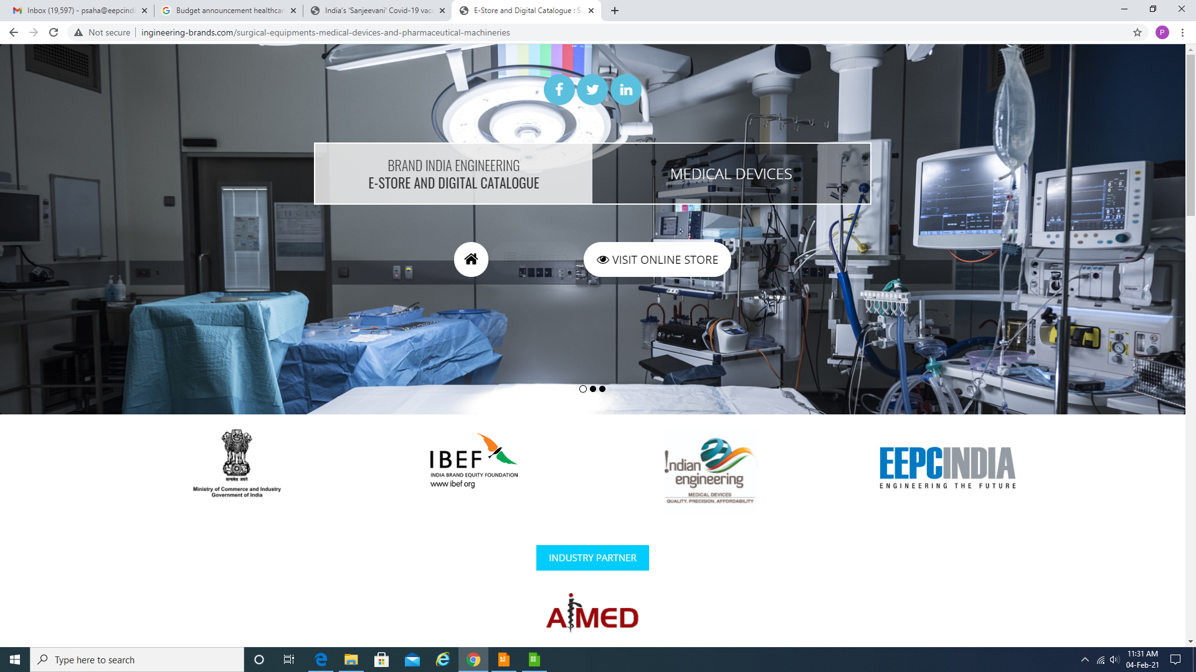
EEPC India activities in Medical Device sector
Nodal agency to coordinate trade promotion activities
Leading Brand India Engineering campaign for the sector globally
Developed an e – product catalogue for the sector
Advocates policy & regulations
Showcases India at the leading International expositions such as at Arab Health, Asia Pharma etc
Organises RBSM, Trade Delegations etc
EEPC India invites interest for B2B meetings.

Slide 12
Thank you
Mr Suranjan Gupta
Executive Director
EEPC India
ed@eepcindia.net
Ms Pallavi Saha
Sr Deputy Director
EEPC India
psaha@eepcindia.net
Address:
‘Vanijya Bhawan’, 1st Floor International Trade Facilitation Centre 1/1, Wood Street Kolkata 700016 Phone : (+91 33) 22890651/52 Fax : (+91 33) 22890654 E-mail : eepcho@eepcindia.net

